Slide 1


Device Management and Overview for Education
Doug Wilson
@ManageDoug
dougw@nowmicro.com
Solutions and Product Manager, Now Micro

Slide 2


Device Lifecycle Company
Hardware Reseller (Dell, HP, Lenovo, and more)
OEM (Digital Signage, Kiosks, Appliances)
Professional Services (Systems Management,
Cloud Solutions, Automation)

Slide 3


Get Invovled
Join or Start your local user group
Participate in forums
  Technet
  MyItForum
  Microsoft Tech Community
  Etc…
Get on Twitter
  Not just for celebrities and presidents
Keep a Blog

Slide 4
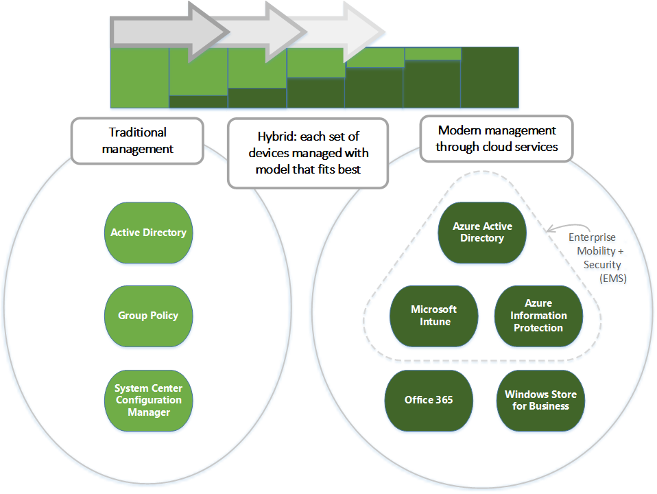

Slide 5
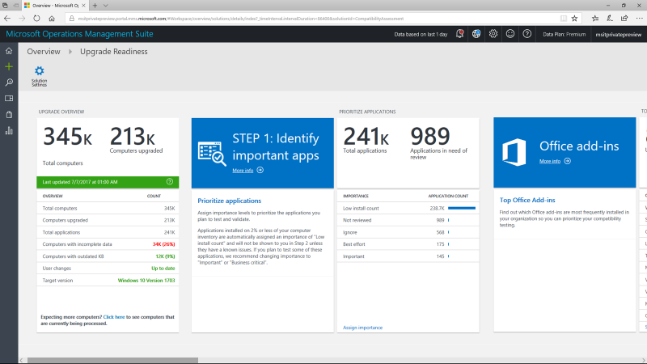
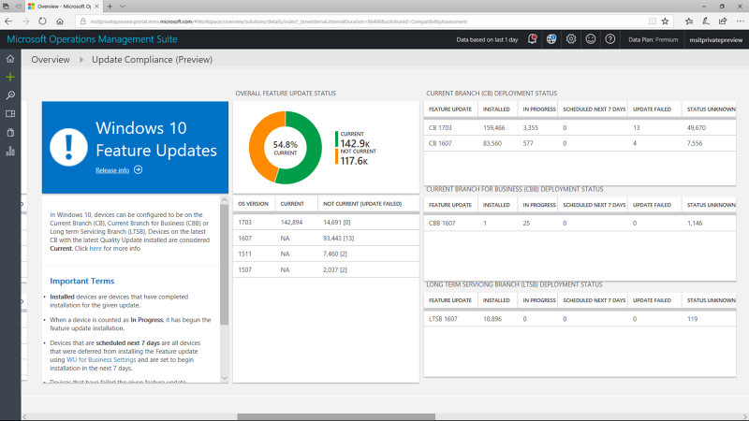
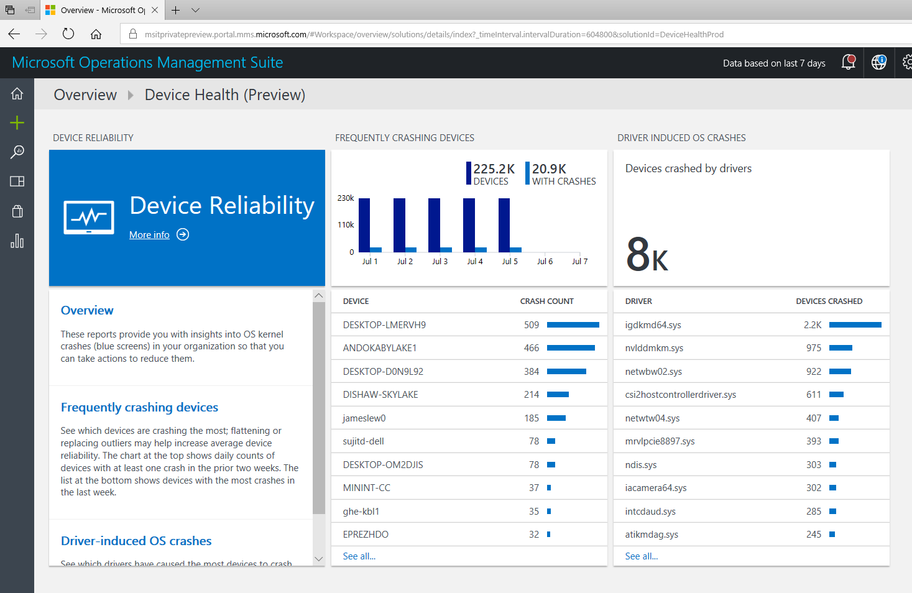
Windows Analytics
A suite of tools reduce deployment and support costs
Upgrade Readiness
Update Compliance
Device Health
Plan upgrades by identifying devices that are ready and identify and resolve top app/driver compat blockers.
Ensure update and antimalware compliance with timely reports for all your devices (even those on the road).
Reduce support costs by proactively identifying and remediating top end-user impacting issues.

Slide 6


Let’s see Intune for Education

